Slide 1
Perception in the Presence of Uncertainty I
Lecture 09-01
RBE500-F17-191
Adj. Prof. Julian Center

Slide 2
Localization within a known Environment

Slide 3
Errors and Perception
So far, we’ve focused on sensor and movement errors.
What about the robot in its environment?

Slide 4
Fundamental Error Sources
There are many sources of error:
Sensors
Robot Pose
Initial Pose Uncertainty.
Movement Uncertainties.
Map Errors
plan != as built
People, furniture, etc.

Slide 5
Consider Robot Pose
First, we must acknowledge that we are working in multiple coordinate systems.
The true map (if available) of our environment provides “world coordinates.”
The robot platform itself provides “platform coordinates.”
Making sense of platform data requires a transformation between coordinates.

Slide 6
Chasing Our Tail
The location of the robot in the world coordinate system:
Is generally approximate
In 2-d, might be expressed as (x, y, θ)
An assumed position, of the robot, x_{t}, may be referenced to some map, m.
Sensor measurements, z_{t}, are an approximation of truth.
Errors in z_{t}, x_{t}, and m must be optimally reconciled.

Slide 7




















Bayesian Graph for Revised Kalman Filter with Map Input
$$ε{}_{}εε$$
$$ε{}_{}εε$$
$$ε{}_{}εε$$
$$ψ_{t−2}$$
$$ψ_{t−1}$$
$$ψ_{t}$$
$$ε{}_{}εε$$
$$ε{}_{}εε$$
$$ε{}_{}εε$$
$$ε_{t−2∆t}$$
$${ ε}_{t−∆t}$$
$$ε_{t}$$
$$u_{t−2∆t}$$
$$u_{t−∆t}$$
$$u_{t}$$
$$ε{}_{}εε$$
$$ε{}_{}εε$$
$$ε{}_{}εε$$
$$δ_{t−∆t}$$
$$δ_{t}$$
$$δ_{t+∆t}$$
$$ε{}_{}εε$$
m

Slide 8
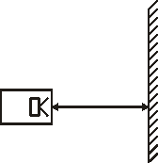
Robot and World
Let’s consider a simple case where the robot makes a range measurement to the wall:

Slide 9
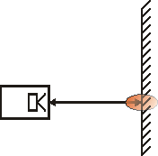
Robot and World
In the best of circumstances there will at least be sensor error.

Slide 10
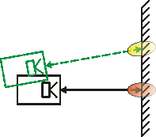
Robot and World
Generally there will also be error in the assumed location and pose.

Slide 11
Reconciling Errors
A given sensor measurement is, essentially a conditional probability that is related to both the pose and the map.
$p\left(z_{t} | x_{t},m\right)$
For an assumed pose, and a map, the range between the robot and an object in the map can be calculated.

Slide 12
Ray Tracing
The technique for determining this range is known as “ray tracing” or “ray casting.”
The idea is to mathematically extend a line from the sensor location to an object.
That forms a predicted range based on the assumed pose and the map (which is assumed available).

Slide 13
Enter Sensor Data
If the assumptions about the pose are good, and the map is accurate, then this ray length is a good prediction of the range measurement.
We compare the sensor measurement to the ray traced prediction.
If the assumptions are good, they should be close. Otherwise they may be far apart.

Slide 14
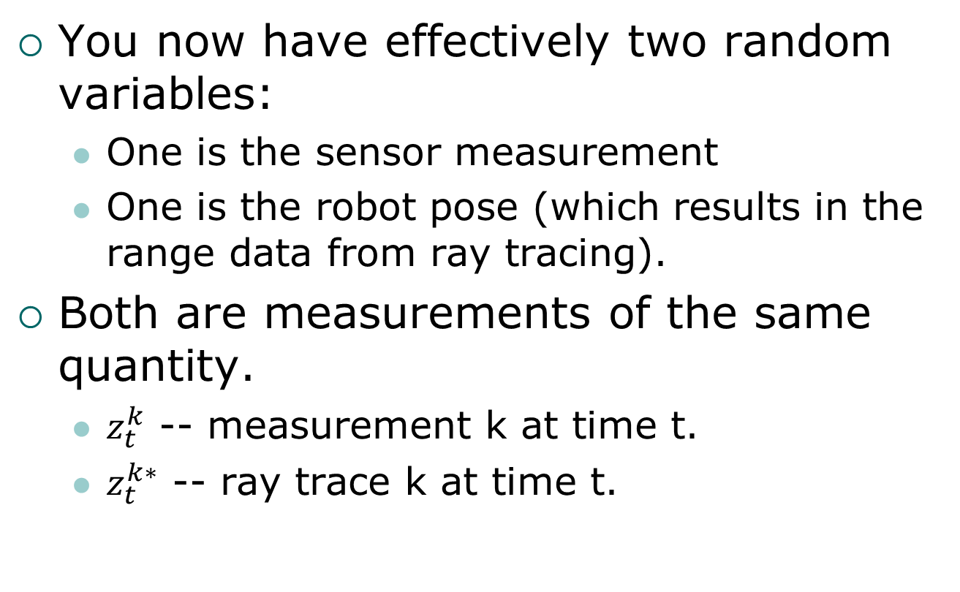
What to do?
You now have effectively two random variables:
One is the sensor measurement
One is the robot pose (which results in the range data from ray tracing).
Both are measurements of the same quantity.
$z_{t}^{k}$ -- measurement k at time t.
$z_{t}^{k∗}$ -- ray trace k at time t.

Slide 15
Probabilities of Real Sensors
Assuming good sensors, maps, and reasonable pose assumptions, the expected relationship between world and sensor is:

Slide 16
Real Environments
There can be “bad data” in the sensor measurements.
“outliers” that mess up the distribution and/or statistics.
That data, however, is real:
People walk in front of sensors
The sensor may or may not catch the edge of an object sometimes
Etc.

Slide 17
Short Ranges
Thus, with some probability, the measured range will fall short of the ray traced range
$$=λexp\left(−λz\right)$$
Don’t let this decay to quickly by choosing $λ$ too large.

Slide 18
Out of Range, Range Measurements
The sensor also only measures out to a finite range. Therefore, there is some probability that we will get a “max range” measurement.

Slide 19
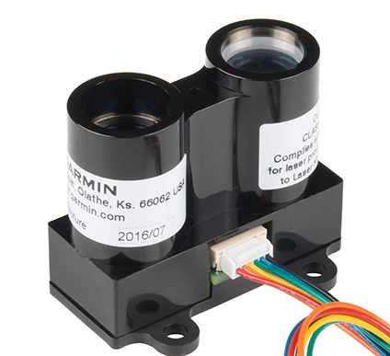
“Near Field” Errors
For sum sensors, the target cannot be too close to the sensor. For lack of a better term, we will call this a “near field” error. This error is often due to parallax.

Slide 20
And, of course, there’s noise…
Depending on the sensor, there may also be a random noise process that underlies the data:

Slide 21
Weighted Sum of Distributions
So, a real sensor, in a real environment, will typically contain a mixture of these random distributions.
By quantifying each process that contributes to the overall probability density, it is possible to develop a model for sensor statistics that is a weighted sum of the individual distributions.
The weights add to 1.

Slide 22
A Combined Distribution
For example, the synthesized distribution for a range sensor might look like:

Slide 23
Going From Sensors to Robots
Of course, sensor errors are not the only error sources.
There are errors that may be introduced by:
The platform – odometry-based errors, mechanical errors, control system errors.
The environment – motion in the environment, map errors, multipath/absorption.

Slide 24
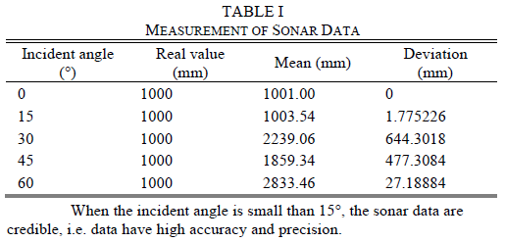
Example – Sonar Sensor
Sonar sensors rely on sufficient reflected signal to reliably resolve distance.
If the angle of incidence is too large, sonar becomes unreliable.

Slide 25
Addressing Uncertainties in System Architecture
In order to incorporate knowledge about the uncertainties in sensor data, platform motion and so on:
These uncertainties must be modeled.
They must be accounted for at the system level
You only need to go far enough to meet specifications.
This implies you know the system specifications!

Slide 26
Consider a Simple Wheeled Robot
Suppose we have a wheeled robot that incorporates the following sensors:
Odometry – Encoder on the robot’s wheels allow measuring the rotation of each wheel.
Ranging – A sonar system is available to measure range from the robot to objects in the robot’s environment.

Slide 27
The Objective - Localization
The goal is to use these sensors to achieve some objective.
For example:
Making a map of the environment
Following walls
Avoiding obstacles
Etc.

Slide 28
The General Process
The odometry and range sensors provide information about:
Sonar can provide information about the location of objects in the environment relative to the robot platform.
Odometry can provide an indication of the location of the robot relative to an initial reference point (dead reckoning).

Slide 29
The General Process
Based on these measurements:
The robot estimates its location and pose in the world.
The robot estimates the location of other objects in the world.
The robot sends control information to the motors (and maybe the sensors).
The robot moves in the environment, changing its pose.
Loop until the goal is reached
Or the robot crashes, or the batteries die, or…

Slide 30
Creating a System Model
Errors and uncertainties can creep in at each of these steps.
By identifying (and quantifying) these sources of error, we can develop a model that accounts for these error in a probabilistic sense.
Then we can develop strategies that account for the uncertainties.
Or at least accounts for enough of them…

Slide 31
System Behavior
Control input:
To move, the robot is given some particular command to move at some velocity and angle,
i.e. some (v,ω) command to the motors.
The result:
Some change in pose $\left(∆x, ∆y, ∆θ\right)$.
Some evaluation of the range information obtained from the new pose.

Slide 32
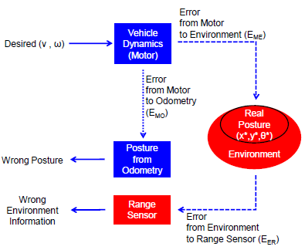
Actuation and Sensing Model
Tseng08 – Analysis of sensor characteristics

Slide 33
Motor to Odometry
The motors are given a command to achieve a particular set point.
This is probably the most error-free part of the system.
The command is what it is…
However, underlying the command are certain assumptions about the physical platform.

Slide 34
Platform Assumptions
For example:
The initial pose is assumed known.
The wheels are assumed to have the same circumference.
Known (and stable) wheelbase.
Single point of wheel contact.
No slip/stall.
Etc.

Slide 35
The Assumptions are not quite True
Most, if not all, of these assumptions are only approximate.
Since the robot controller assumes they are correct:
The internal world model of the robot is updated assuming perfection.
In fact, the true response of the robot, will not follow (exactly) the assumed path.

Slide 36
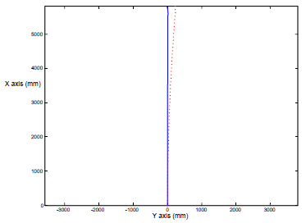
Motor to Odometry Errors
Simple things like slight differences in wheel circumference can lead to accumulating position errors over time:
Desired
Achieved

Slide 37
The Odometry Can’t Fix This…
Note that without some additional information, the robot cannot resolve this discrepancy.
It simply doesn’t know it’s drifting!
Adding an environmental sensor is necessary to detect the problem:
External tracking of the robot by another system.
Using discrepancies between range data and map data to correct odometry.

Slide 38
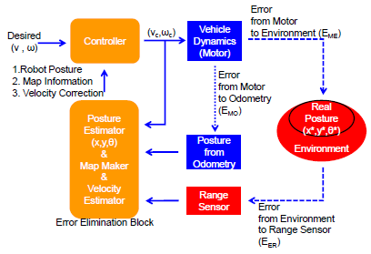
Example System Architecture
The goal is to model and estimate errors to control this accumulation.

Slide 39
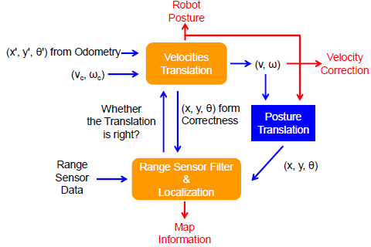
Closing the Loop
The basic idea is to use available measurements to assess and correct updates to the robot’s state:
Error Elimination
Block Detail

Slide 40
Taxonomy of Localization Problems

Slide 41
Environental Factors
Local versus Global Localization
Position Tracking with known starting pose is Local.
If the initial pose is unknown, the problem is Global.
“Kidnapped” robot is Global and important because it models recovery from failures.
Static Versus Dynamic
People, Movable furniture, etc.
Structural Changes.

Slide 42
Robot Behavior
Passive versus Active
Passive: Location module only observes.
Active: Location module drives the robot and may balance acquiring information with going for the goal.
Single Robot Versus Multi-Robot
Multiple robots may be able to communicate information with each other.
They may be able to navigate relative to each other.

Slide 43
What We Will Focus on in This Lecture
We will focus passively tracking a single robot in a static environment using;
A beam range sensor locating landmarks.
A imaging system determining bearing angles to multiple landmarks.

Slide 44
Tracking in a known environment

Slide 45
Localization in a Known Environment
We assume we have an accurate map of the environment.

Slide 46
Types of Maps
Landmark Maps
A list of landmarks, their locations, and their distinguishing characteristics.
Occupancy Grid Maps
Environment represented by a grid with cells either open or occupied.
Mixed
It is possible to mix the two types.

Slide 47
The Map Can Used to Predict Ranges to Landmarks
For range sensors, such as Sonar and Lidar, ray tracing from an assumed robot pose to an object is used to predict the expected range measurement.
This prediction is subtracted from the range measurement to produce the “innovation”.
Nonlinearities inherent in ray tracing must be modeled.

Slide 48
The Map Can Be Used to Predict Bearing Angles to Image Landmarks
For imaging systems (calibrated cameras), the map can be used to predict bearing angles to image landmarks give the estimated pose (position and heading) of the robot.
Landmark features are extracted by the imaging system.
Differences serve as innovations.

Slide 49
















Bayesian Graph for Revised Kalman Filter with Map Input
$$ε{}_{}εε$$
$$ε{}_{}εε$$
$$ε{}_{}εε$$
$$ψ_{t−2}$$
$$ψ_{t−1}$$
$$ψ_{t}$$
$$ε{}_{}εε$$
$$ε{}_{}εε$$
$$ε{}_{}εε$$
$$ε_{t−2}$$
$${ ε}_{t−1}$$
$$ε_{t}$$
$$u_{t−2}$$
$$u_{t−1}$$
$$u_{t}$$
$$ε{}_{}εε$$
$$ε{}_{}εε$$
$$ε{}_{}εε$$
$$δ_{t−1}$$
$$δ_{t}$$
$$δ_{t+1}$$
$$ε{}_{}εε$$
m

Slide 50
The Correspondence Problem
If landmarks are easily distinguished, we can use either an EKF or UKF employing the motion and sensor models we have discussed previously.
If landmarks are hard to distinguish, we must use some method to identify which landmark is in the sensor beam or image. This is the correspondence problem.

Slide 51
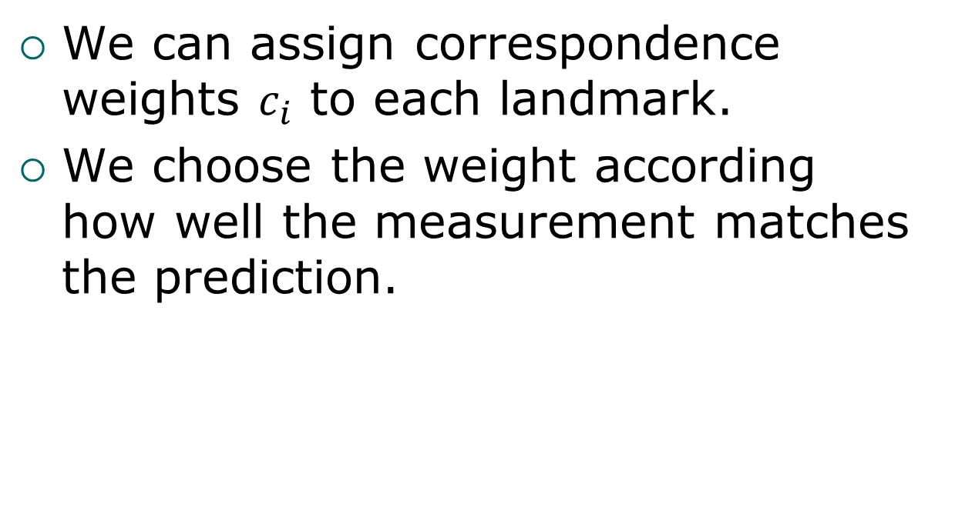
Solving the Correspondence Problem
We can assign correspondence weights $c_{i}$ to each landmark.
We choose the weight according how well the measurement matches the prediction.

Slide 52
Multi-Hypothesis Tracking
When it is difficult to resolve the correspondence problem, it may be possible to use multi-hypothesis tracking.
The downside is that multiple EKFs must be implemented, which may not be possible with limited computer resources.

Slide 53
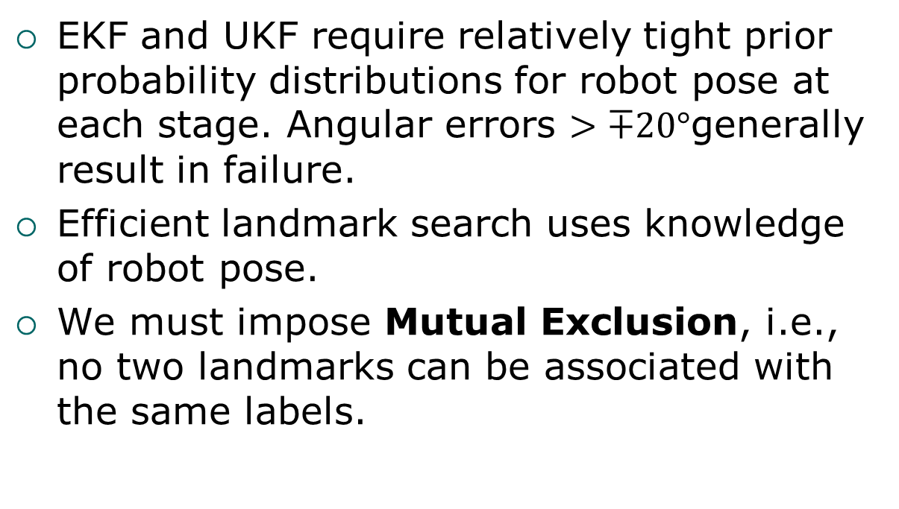
Practical Considerations(1)
EKF and UKF require relatively tight prior probability distributions for robot pose at each stage. Angular errors $>∓20°$generally result in failure.
Efficient landmark search uses knowledge of robot pose.
We must impose Mutual Exclusion, i.e., no two landmarks can be associated with the same labels.

Slide 54
Practical Considerations(2)
We must reject outliers.
EKFs or UKFs do not handle hard constraints, such as, not being inside a wall.
Neither EKFs nor UKFs can handle negative information, i.e., not see a landmark that is expected to be there.
Therefore, we will study grid and Monte Carlo methods in later lectures.

